Slide 1
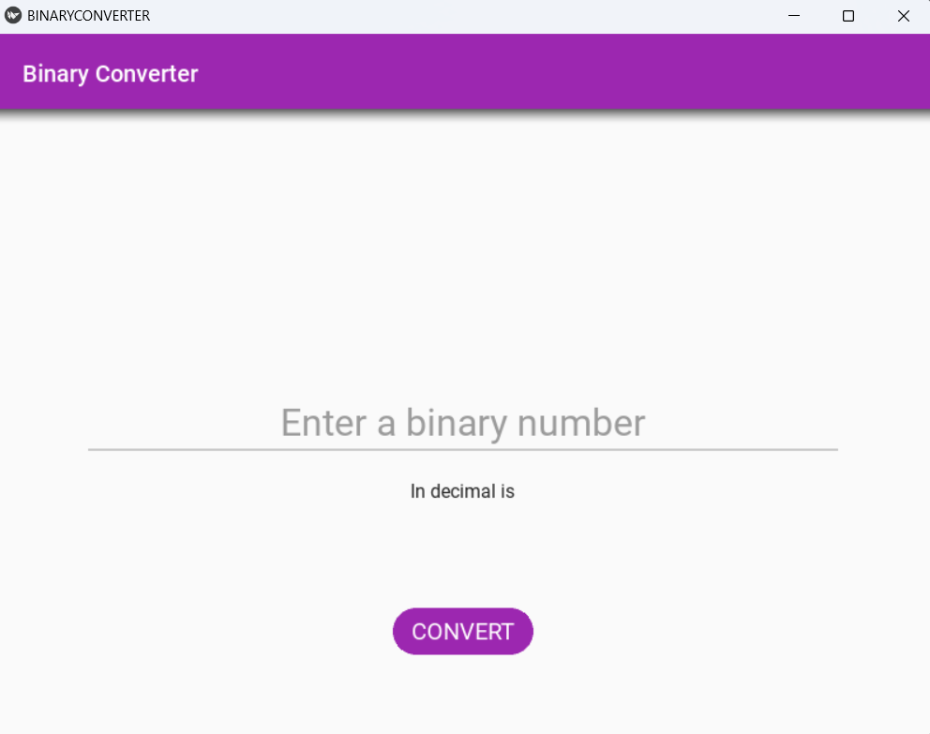
Binary converter
Notes:
NOTE:
To change the image on this slide, select the picture and delete it. Then click the Pictures icon in the placeholder to insert your own image.

Slide 2
BINARY CONVERTER
Compiled By:
HEENA(2210990398)

Slide 3
INTRODUCTION
Abstract
Block Diagram
Lower Level Approach
VS Code
Result

Slide 4
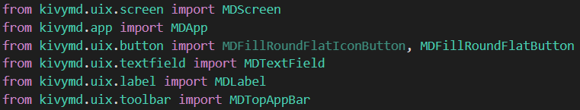
ABSTRACT
We need to have KivyMD library installed in the system for the project. Use the below command to install KivyMD on your machine. Pip install KivyMD
Create a folder and call it Binary Converter app. In the folder created, create a new file , call it project.py and add the snippet below:
The snippet above, imports the component widgets we require to build BinaryConverterApp. This Class BinaryConverterApp is derived from the App() class of the kivyMD. This class is the basic class for creating the kivyMD application.

Slide 5
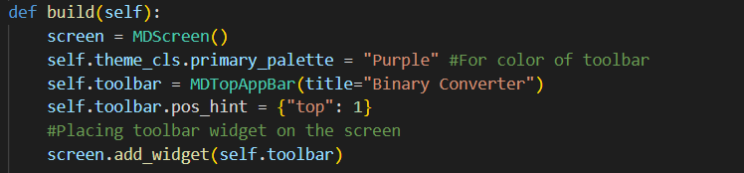
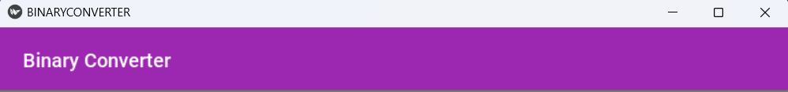

CONTD.
Define the build function with the self argument. The build function is used to define the screen for the widget to be shown on it . Then we add the widgets one by one :
Toolbar for the title or the heading of the page.
A text field for the user input.
Label for the “in decimal is”.
Button for submitting the binary number.

Slide 6
CONTD.
Define the convert function with self and temp argument. In this function we will convert the binary number to decimal. We need to create two different arguments for button is self and then we need to fetch the user entered number.
In the convert function we will create a variable named ‘result’. The value entered by the user is of string type. Therefore, using the int() function the string type value gets converted into an integer type of value base,2 i.e. binary number.

Slide 7
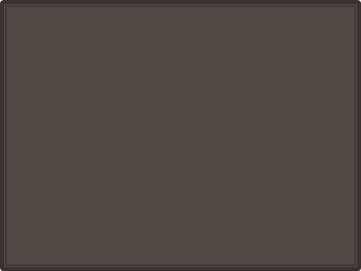
BLOCK DIAGRAM
User-entered binary number of string type
Convert str type user value to integer type of base 2 i.e. binary number.
Print converted binary number

Slide 8
LOWER LEVEL APPROACH
User case 1: The program is about binary conversion to decimal conversion.
2. Binary Converter is simple and easy to use tool. All you have to do is type the binary number in the first text field provided. After that click the convert button.
3. The decimal representation for your binary number will immediately appear in the field below.
We convert the binary numbers to decimal numbers to make it easier to interpret huge binary values in a human-readable format

Slide 9
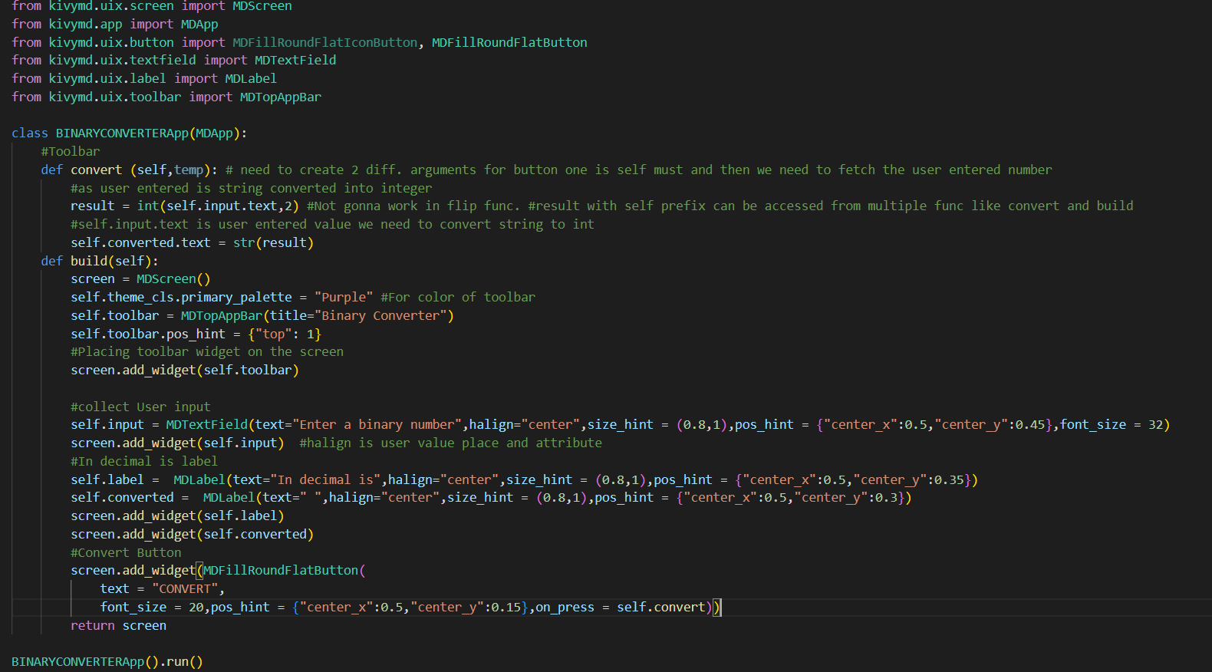
VS CODE

Slide 10
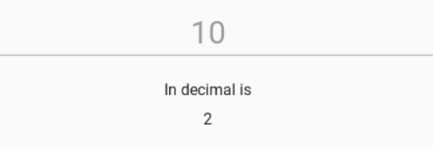
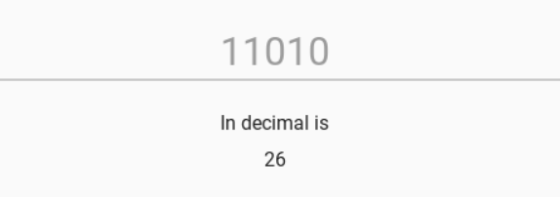
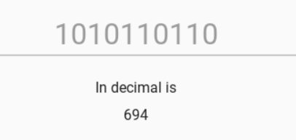
result

Slide 11
Thank you

